Slide 1
Online Learning Applications Project
Dynamic Pricing
Authors:
Carminati Gabriele
Compagnoni Riccardo Domingo
De Introna Federico
Di Giore Francesco
Fossa’ Chiara
Academic Year 2024/2025
School of Industrial and Information Engineering
Master of Science - Computer Science

Slide 2
Project: Overview
The goal of the project is to design online learning algorithms to sell multiple types of products under production constraints.
Parameters
Number of rounds T
Number of types of products N
Set of possible prices P (small and discrete set)
Production capacity B (for simplicity, there is a total number of products B that the company can produce)
Buyer behavior
Has a valuation vi for each type of product in N
Buys all products priced below their respective valuations
At each round t ∈ T:
The company chooses which types of product to sell and set price pi for each type of product
A buyer with a valuation for each type of product arrives
The buyer buys a unit of each product with price smaller than the product valuation

Slide 3
Requirement 1: Single product and stochastic environment

Slide 4
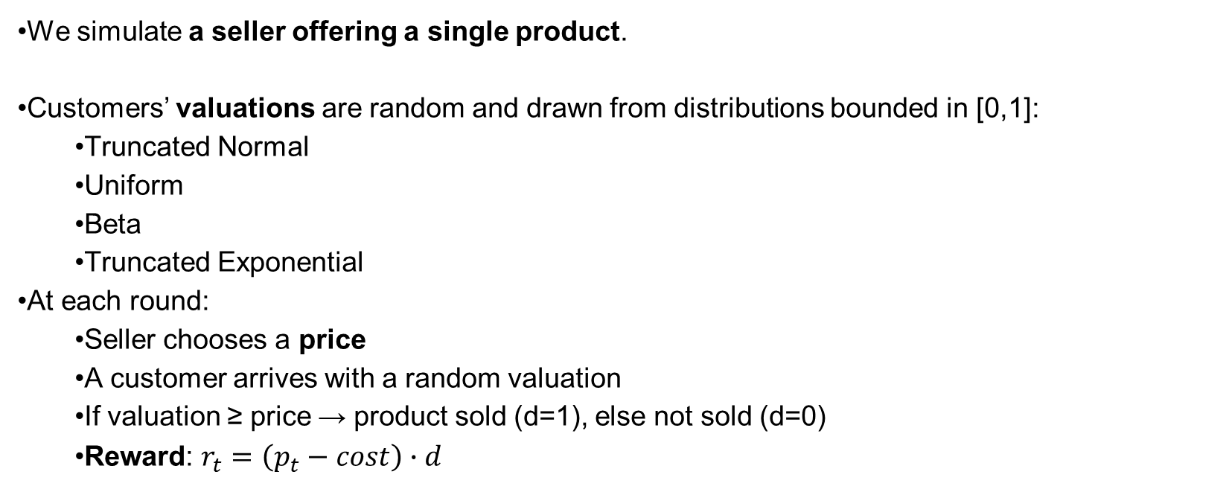
Environment
•We simulate a seller offering a single product.
•Customers’ valuations are random and drawn from distributions bounded in [0,1]:
•Truncated Normal
•Uniform
•Beta
•Truncated Exponential
•At each round:
•Seller chooses a price
•A customer arrives with a random valuation
•If valuation ≥ price → product sold (d=1), else not sold (d=0)
•Reward: $r_{t}=\left(p_{t}−cost\right)∙d$

Slide 5
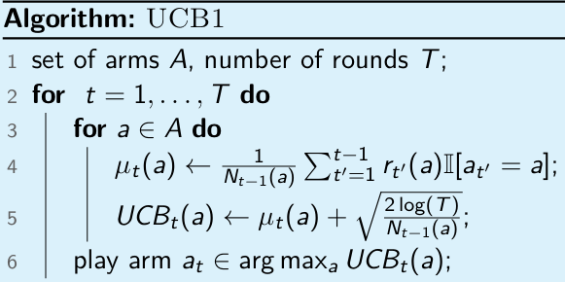
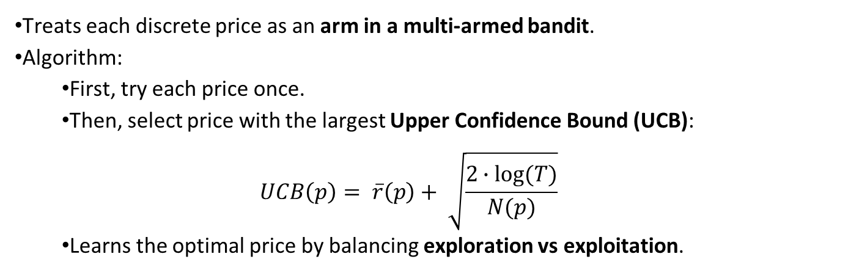
Agent Case 1: UCB1 without inventory constraint
•Treats each discrete price as an arm in a multi-armed bandit.
•Algorithm:
•First, try each price once.
•Then, select price with the largest Upper Confidence Bound (UCB):
$$UCB\left(p\right)= \overline{r}\left(p\right)+ \sqrt{\frac{2∙log⁡(T)}{N(p)}}$$
•​​Learns the optimal price by balancing exploration vs exploitation.

Slide 6
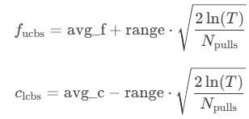
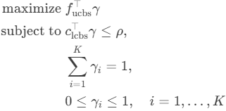
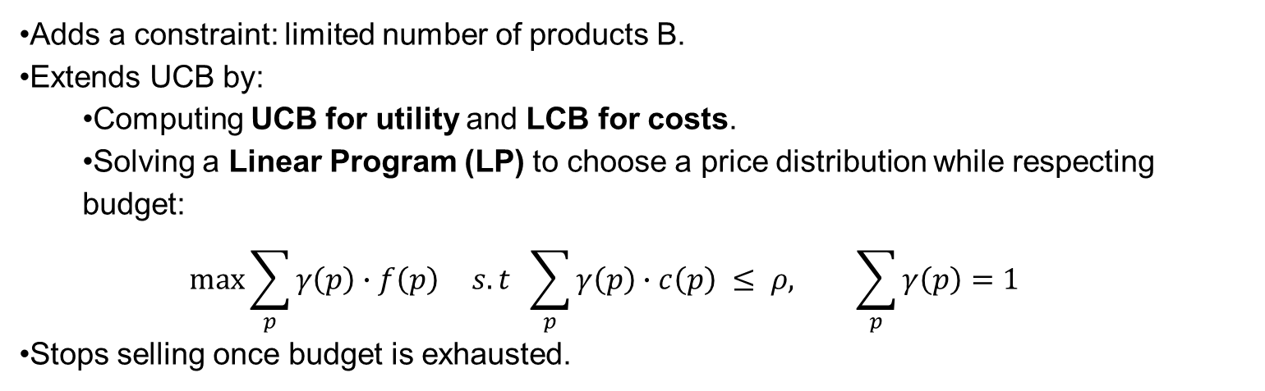

Agent Case 2: UCB-like with inventory (budget) constraint
•Adds a constraint: limited number of products B.
•Extends UCB by:
•Computing UCB for utility and LCB for costs.
•Solving a Linear Program (LP) to choose a price distribution while respecting budget:
$$\max{\sum_{p}{γ\left(p\right)∙f\left(p\right) }s.t \sum_{p}{γ\left(p\right)∙c\left(p\right) ≤ ρ, \sum_{p}{γ\left(p\right)=1}}}$$
•Stops selling once budget is exhausted.
Seller’s utility: $f_{t}\left(p_{t}\right)=p_{t}1[v_{t}≥p_{t}]$
Seller’s cost: $c_{t}\left(p_{t}\right)=1[v_{t}≥p_{t}]$

Slide 7
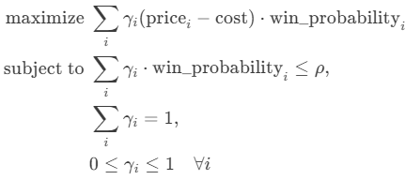
Baseline (Clairvoyant)
Knows the true distribution of valuations.
Chooses the price (or mix of prices) that maximizes expected profit under budget constraints.
Computed by solving an LP.
Serves as the upper bound against which we compare regret.
N.B.: cost is {0,1}

Slide 8
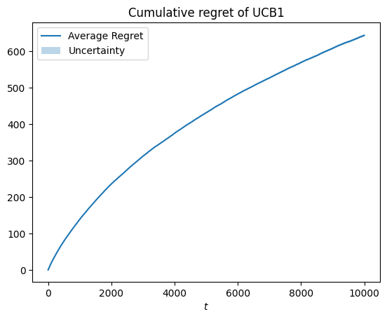
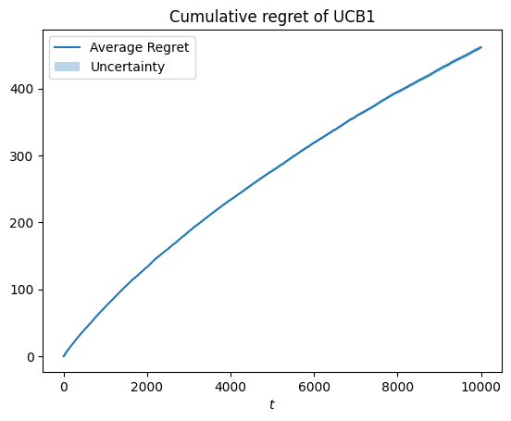
Trials and graphs without budget constraints
Truncated Normal Distribution
Cumulative Regret: grows sublinearly → UCB1 converges.
Number of Pulls: most mass on the optimal price, with some exploration.
Uniform Distribution
Cumulative Regret: sublinear, but noisier.
Pulls: spread across several prices → higher exploration due to uncertainty.

Slide 9
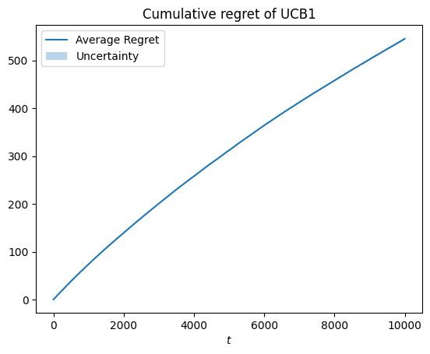
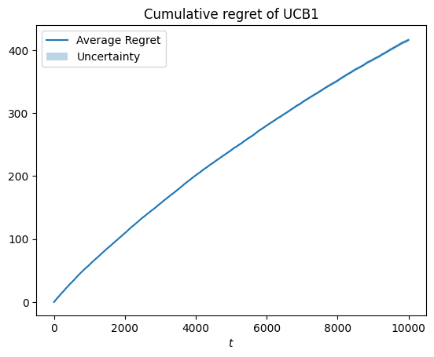
Trials and graphs without budget constraints
Beta Distribution
Optimal price is lower (since mean valuation is low).
Agent converges well: pulls mostly the optimal lower prices.
Truncated Exponential
Optimal price shifts higher compared to Beta.
Again, UCB1 identifies the best price and regret stays sublinear.

Slide 10
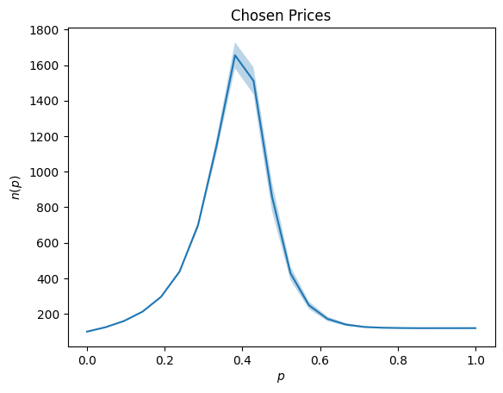
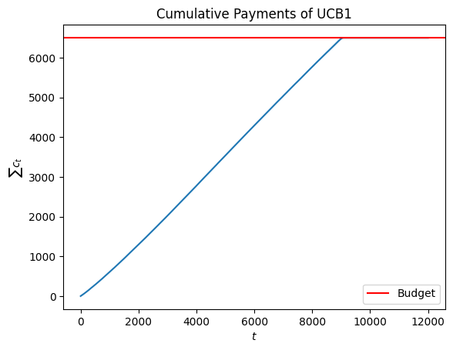
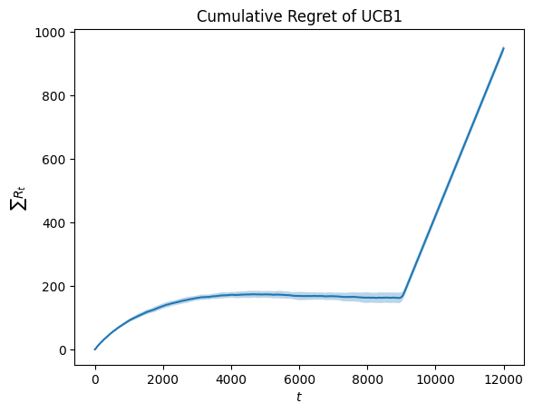
Trials and graphs with budget constraints
Normal Distribution
Chosen Prices: Agent concentrates on 2 prices near 0.5
Cumulative Payments: Grows steadily → exactly stops at budget.
Cumulative Regret: Sublinear, then flattens once budget is exhausted.

Slide 11
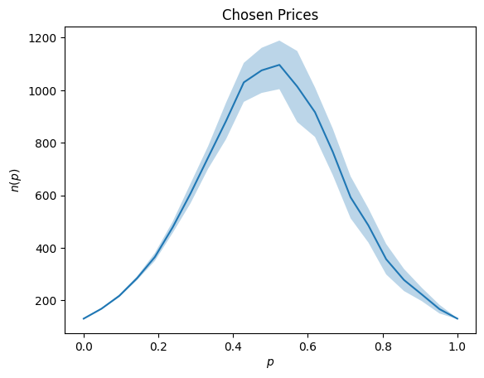
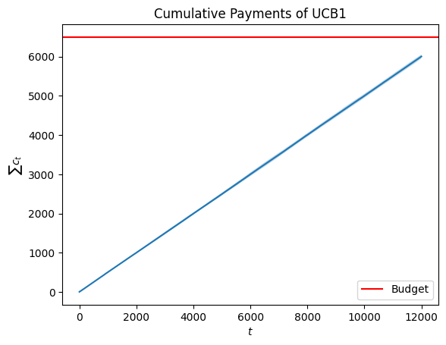
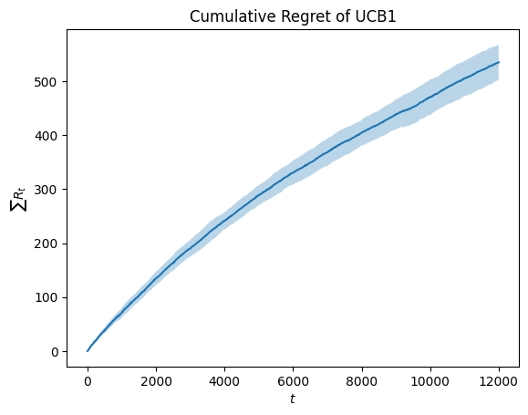
Trials and graphs with budget constraints
Uniform Distribution
Agent does not always spend the full budget.
Pulls spread over multiple prices → higher variability.
Regret grows with wider uncertainty.

Slide 12
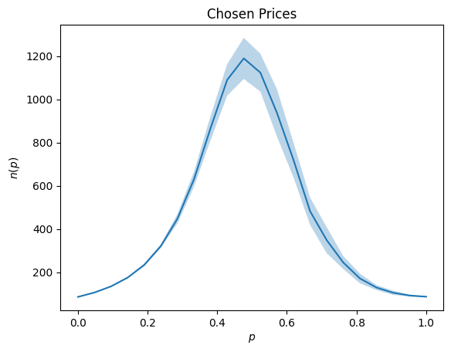
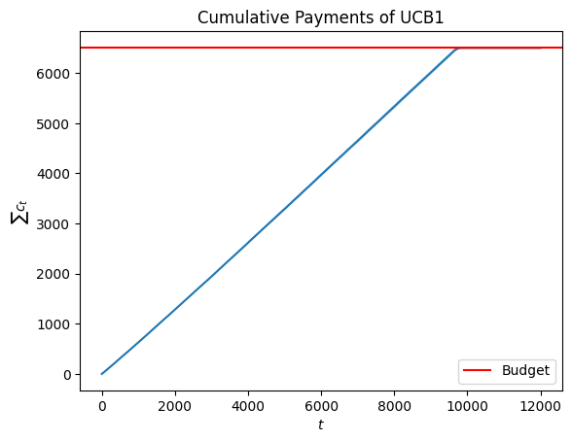
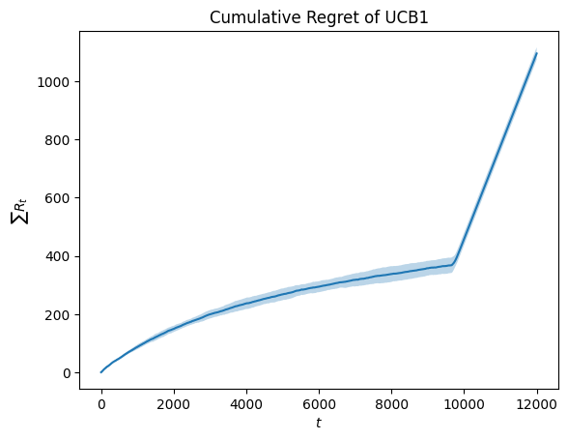
Trials and graphs with budget constraints
Beta Distribution
Like normal case, budget is fully used.
Optimal prices are lower

Slide 13
Requirement 2: Multiple products and stochastic environment

Slide 14
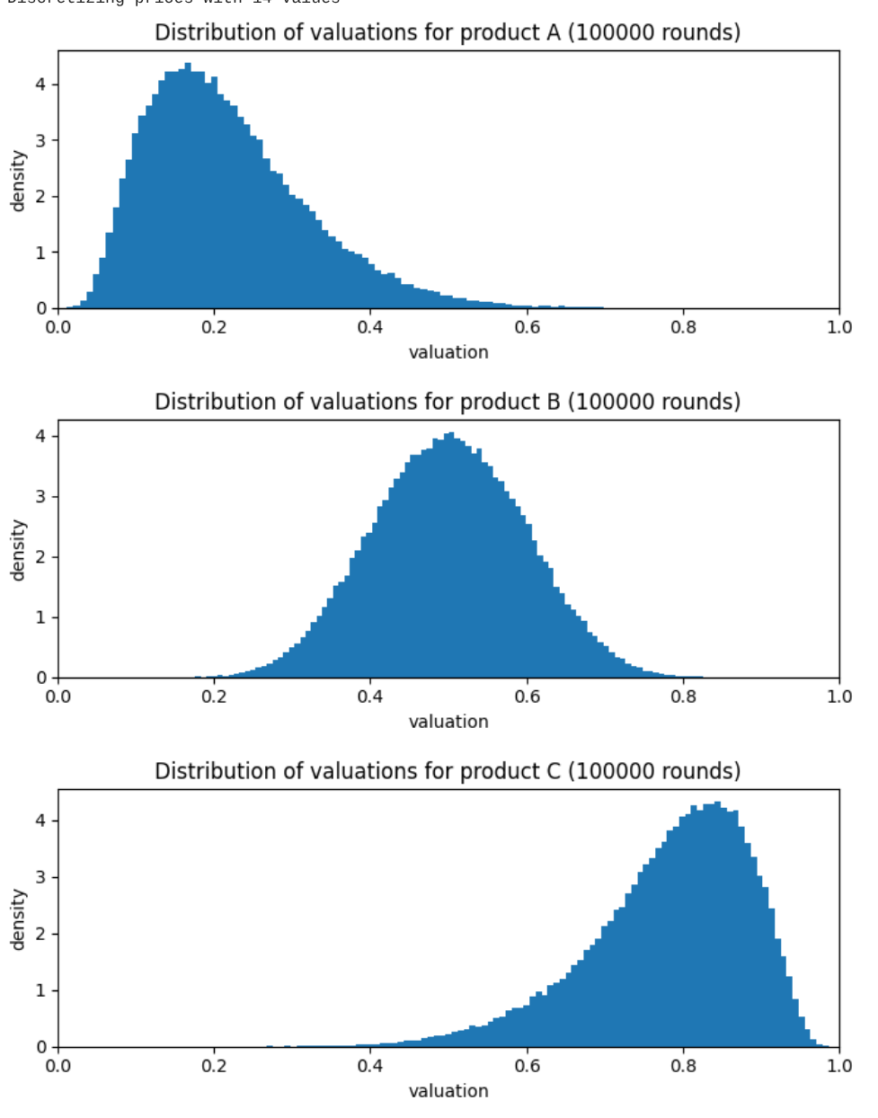
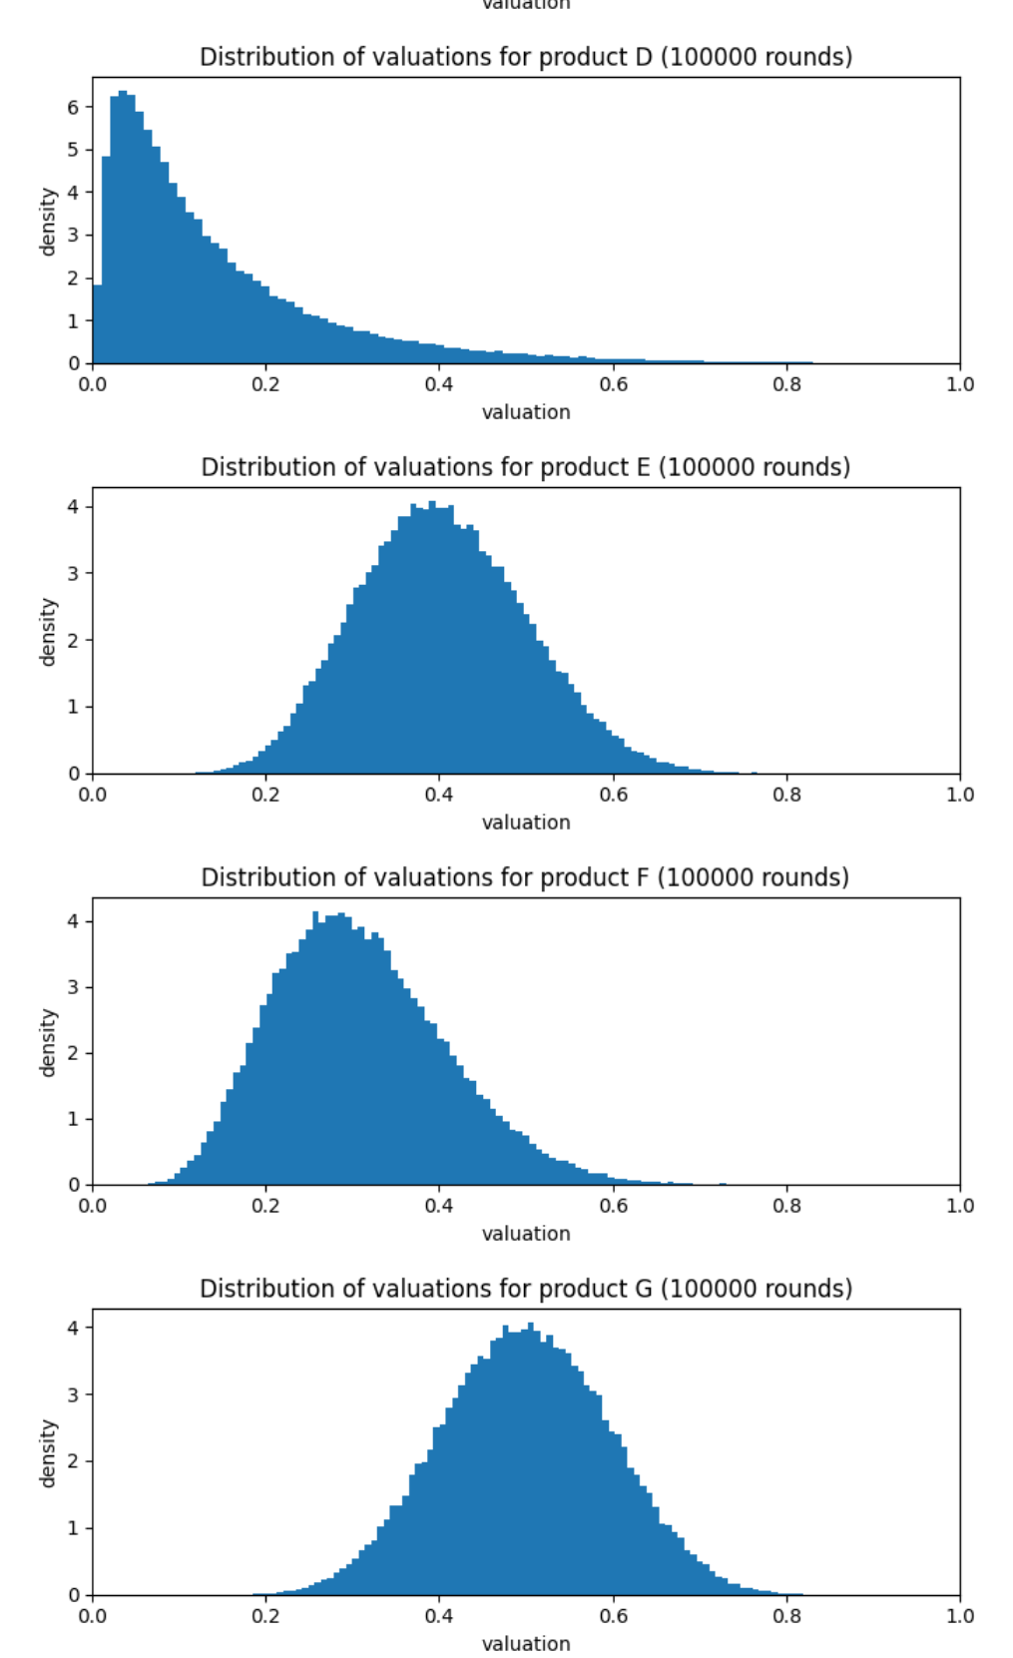
Environment
We simulate a seller offering multiple products.
Customer’s valuations are modeled with joint distribution over all the products.
Specifically we used a multivariate logit normal distribution
Approximating the latent gaussian parameters with the delta method
At each round:
The seller chooses a price for each product
A customer arrives with a valuation for each product sampled from the distribution
If valuation>price for a given product a purchase happens (d=1)
For each product the reward is computed as reward = price * d, so the seller agent receives a cumulative reward of sum(rewards)

Slide 15
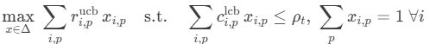
Agent: Combinatorial UCB with Gaussian Processes
The agent uses a GP with RBF kernel to model each product’s demand curve
At each round the agent:
Estimates demand by computing for each product
UCB: to estimate the probability of the product to get sold at each price
LCB: to estimate the expected reward for each price
Optimizes budget by solving a linear problem
Check the image for the LP
Maximizes the reward without exceeding the cost of the per-round budget
Samples a discrete action from the optimal fractional solution
Updates GPs with observations from the environment

Slide 16
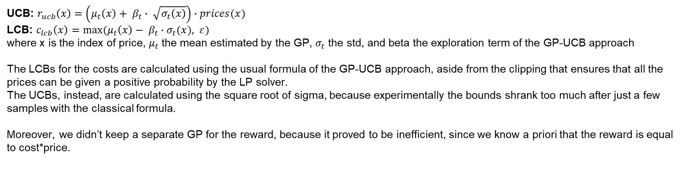
Agent: Combinatorial UCB with Gaussian Processes
UCB: $r_{ucb}\left(x\right)=\left(μ_{t}\left(x\right)+ β_{t}∙ \sqrt{σ_{t}\left(x\right)}\right)∙prices(x)$
LCB: $c_{lcb}\left(x\right)=max⁡(μ_{t}\left(x\right)− β_{t}∙σ_{t}(x), ε)$
where x is the index of price, $μ_{t}$the mean estimated by the GP, $σ_{t}$ the std, and beta the exploration term of the GP-UCB approach
The LCBs for the costs are calculated using the usual formula of the GP-UCB approach, aside from the clipping that ensures that all the prices can be given a positive probability by the LP solver.
The UCBs, instead, are calculated using the square root of sigma, because experimentally the bounds shrank too much after just a few samples with the classical formula.
Moreover, we didn’t keep a separate GP for the reward, because it proved to be inefficient, since we know a priori that the reward is equal to cost*price.

Slide 17
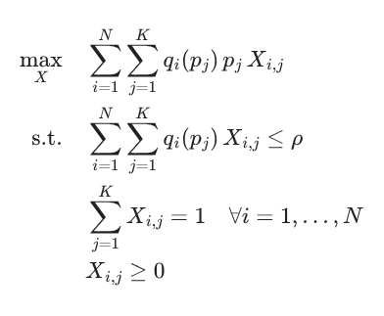
Baseline: clairvoyant
Clairvoyant knows the real purchasing probabilities of each product.
By solving the following LP problem it choose the mix of price for each product that maximizes the reward:
Where:
X_i,j: Fractional probability of selecting price (p_j) for product (i)
p_j: Candidate price for the (j)-th price level.
q_i(p_j): Probability that product (i) is purchased at price (p_j).
rho: Maximum expected units that can be sold in a round (budget/pacing constraint).
N.B.: cost is {0,1}, so omitted in the constraint

Slide 18
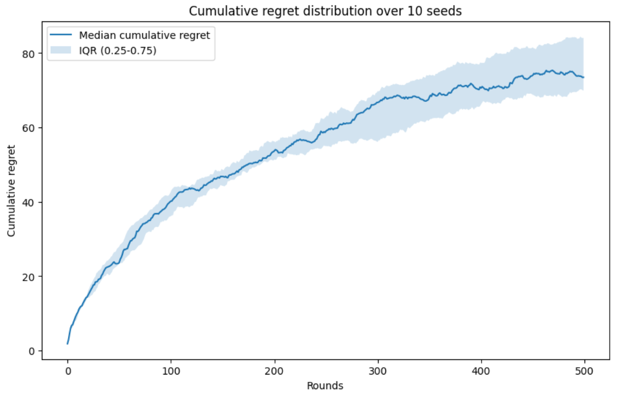
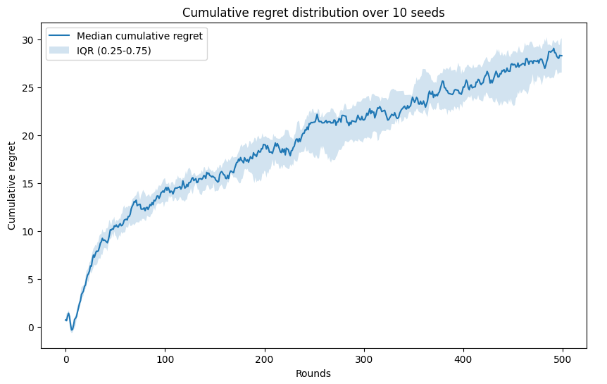
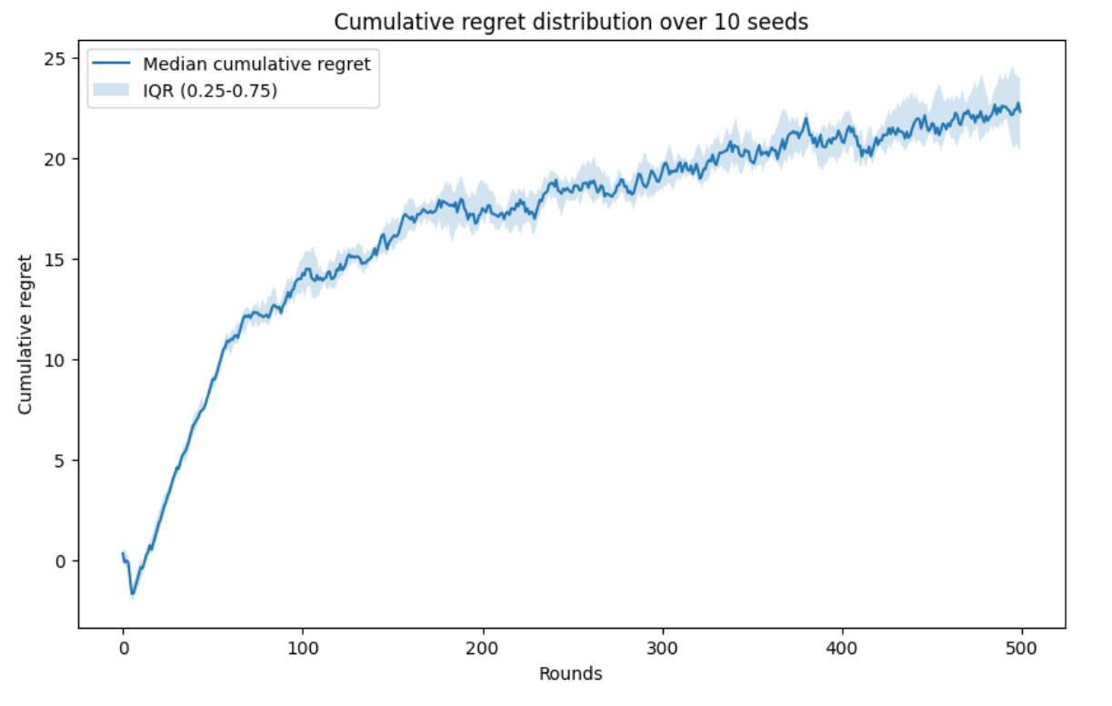
Trials with uncorrelated products
With B >> T:
The median cumulative regret over 10 trials is clearly sublinear
With B = T:
The median cumulative regret over 10 trials is again sublinear
With B << T:
The median cumulative regret over 10 trials is still sublinear

Slide 19
Trials with uncorrelated products
From the previous graphs we can see that the cumulative regret is sublinear even in the worst case where the budget is small compared to T
We can observe that in the more complicated situations the regret tend to grow faster in the beginning bust still reach a sublinear growth at the end. This is likely due to less exploration constrained by the budget.
In the more complicated cases the grow is also a bit noisier than in the most favorable one.

Slide 20
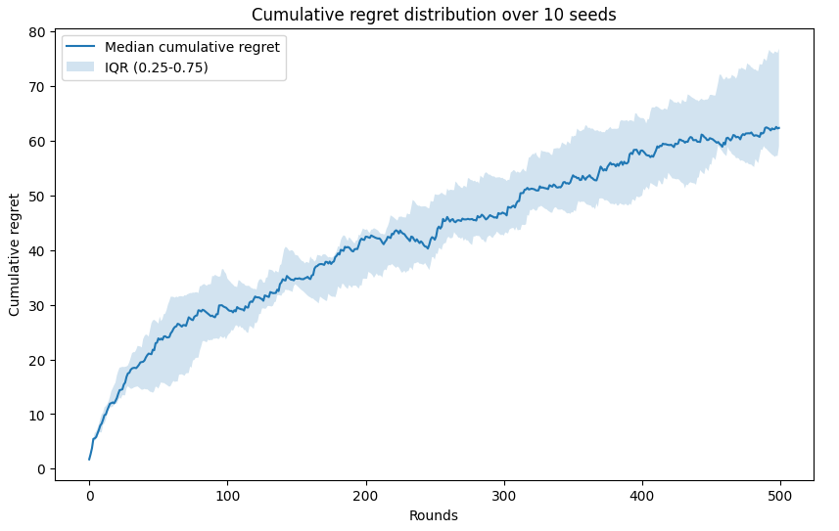
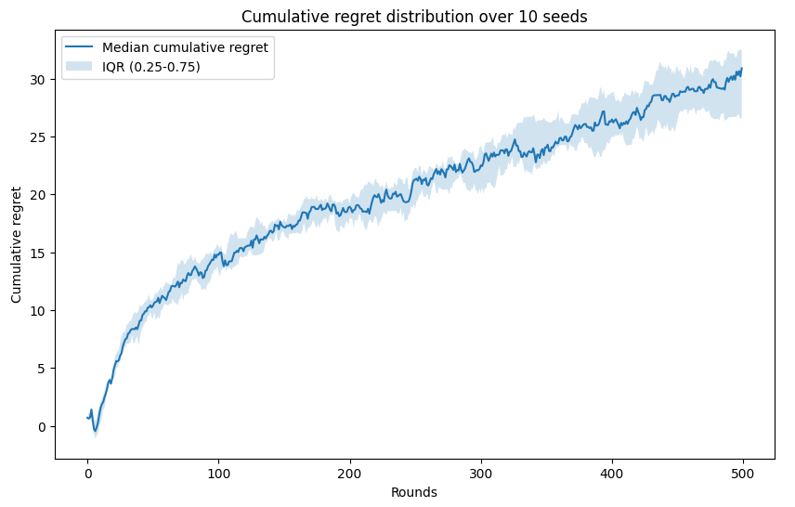
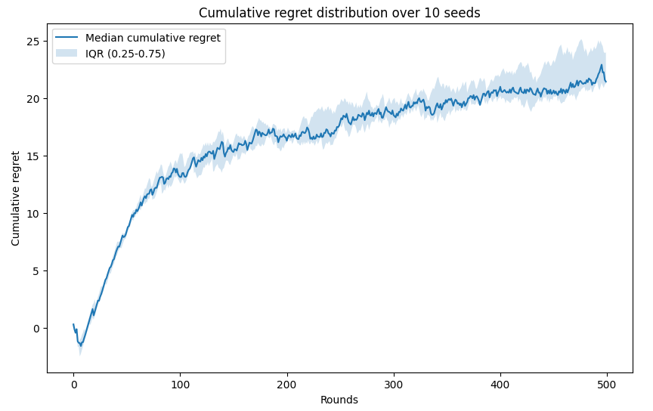
Trials with correlated products
With B >> T:
The median cumulative regret over 10 trials is sublinear
With B = T:
The median cumulative regret over 10 trials is again sublinear
With B << T:
The median cumulative regret over 10 trials is still sublinear

Slide 21
Trials with correlated products
As in the uncorrelated product case we can see from the graphs that the regret is sublinear even when the budget is really small.
We can observe a similar trend to the uncorrelated product case where reducing the budget makes regret to grow faster in the first rounds and reach a sublinear growing later.

Slide 22
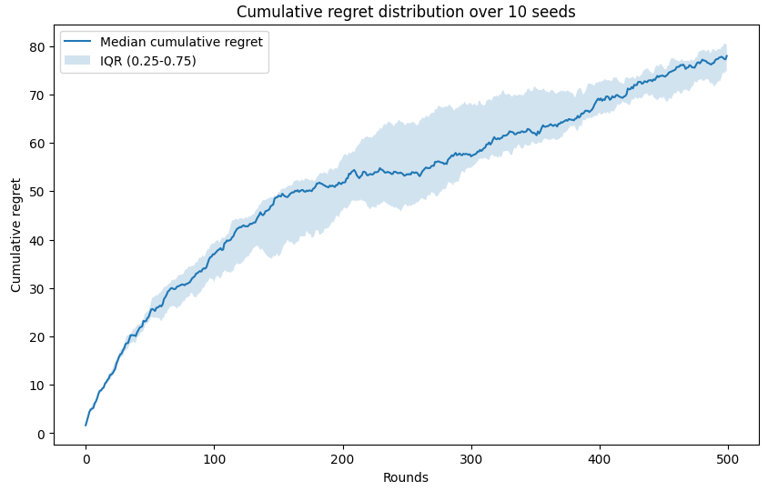
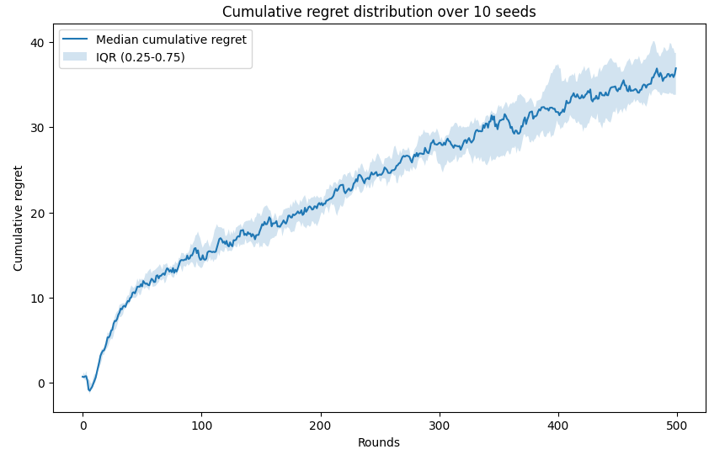
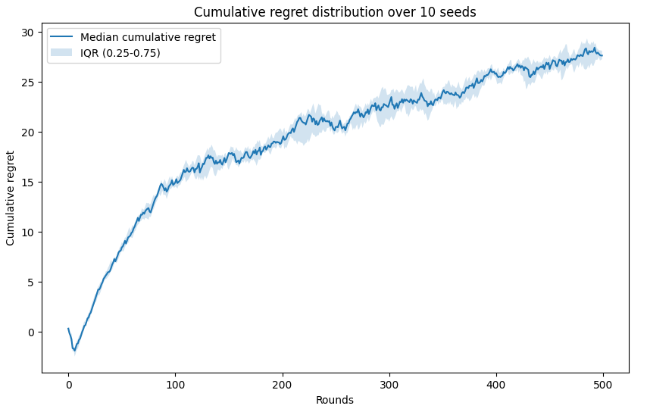
Trials with custom covariance matrix
Up to this point, we used a covariance matrix whose values outside the principal diagonal were all the same. From now on, we use a covariance matrix whose values are different and there are products that are correlated and products that are not correlated.
With B >> T
With B = T
With B << T

Slide 23
Trials with custom covariance matrix
Even in this case the agent is able to achieve sublinear regret in every situation, proving that is a consistent and effective learning agent in these scenarios.
By the previous trials we can highlight how increasing product correlation leads to an increased variance in the regret, and how reducing the budget limits the agent exploration leading to steeper regret graphs in the initial rounds.

Slide 24
Requirement 3: Best-of-both-worlds algorithms with a single product

Slide 25
Requirement features
Dynamic pricing in rapidly changing markets requires algorithms that can:
Adapt to non-stationary demand patterns.
Respect global budget limits over long horizons.
Balance exploration and exploitation without prior knowledge of distributions.
We test a Primal-Dual agent based on EXP3.P in multiple nonstationary valuation environments.

Slide 26
Nonstationary Pricing Environments
We model customer valuations with three dynamic probability distributions restricted to [0,1]:
Beta distribution: allows flexible skewness and concentration, capturing diverse preference profiles.
Truncated Normal distribution: captures valuations centered around a mean, with varying spread.
Truncated Exponential distribution: produces heavily skewed valuations, either toward low or high willingness to pay.
Nonstationarity is introduced through random mode changes at every round:
Jump: sudden reinitialization of parameters.
Drift: gradual evolution, mimicking slow market trends.
Spike: temporary concentration around extreme values.
This creates highly volatile demand conditions where a static pricing strategy would fail.

Slide 27
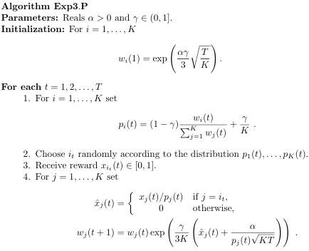
Learning Agent
We design a Primal-Dual EXP3.P agent.
Primal step (EXP3.P):
Maintains weights over possible prices.
Chooses prices with probabilities based on exponential weights.
Corrects bias and balances exploration (γ) with exploitation.
Dual step (budget pacing):
Updates a Lagrangian multiplier λ via online gradient descent.
Penalizes overspending, steering the agent to respect average budget ρ = B/T.
Conservatism emerges naturally when λ increases.
This ensures the agent remains feasible while adapting to changes.

Slide 28
Baseline
We compare against a clairvoyant benchmark:
Knows the true win probability at each round.
Chooses the optimal distribution over prices by solving a linear program:
Maximize expected reward (price – cost) × probability of sale.
Constrained by expected budget usage ≤ ρ.
This provides the upper bound on performance.
Regret is defined as the gap between the clairvoyant and the agent.

Slide 29
Experiment Setup
Horizon: T = 7000 rounds.
Budget: B = 3200 (average ρ ≈ 0.46 per round).
Number of arms: K = O(T^⅓) ≈ 18 price points in [0,1].
Agent step size (η): T^(-½).
Trials: 20 independent epochs with different random seeds.
Metrics:
Chosen price distribution (which prices the agent prefers).
Cumulative payments (how budget is spent over time).
Cumulative regret (distance to clairvoyant benchmark).

Slide 30
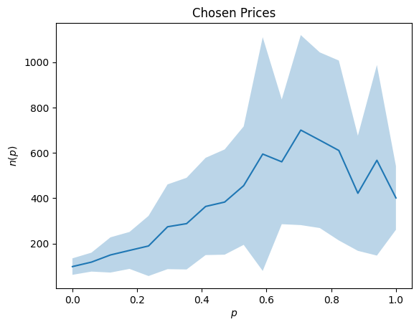
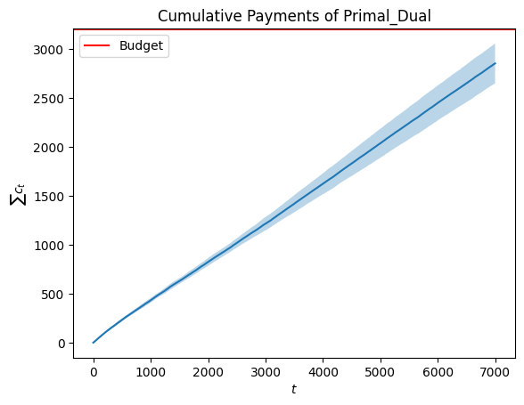
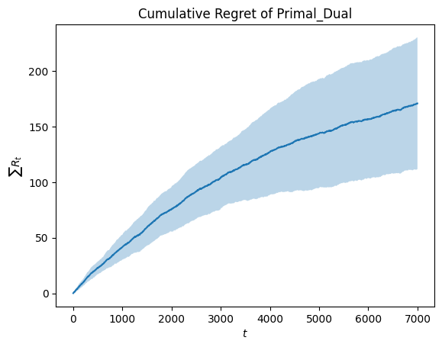
Results: Beta Environment
Chosen Prices: Agent develops a strong preference around price ≈ 0.7. Variability remains high due to both nonstationarity and EXP3.P exploration. Peaks shift between runs, reflected in wide uncertainty bands.
Cumulative Payments: Payments grow sublinearly. Budget never fully exhausted, indicating the pacing mechanism prevents overspending but leaves resources unused.
Cumulative Regret: Increases sublinearly, which aligns with no-regret theory. However, regret variance is large, suggesting sensitivity to environment fluctuations.

Slide 31
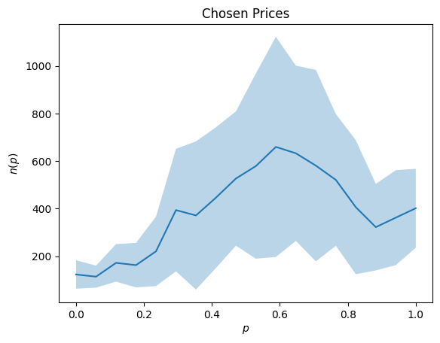
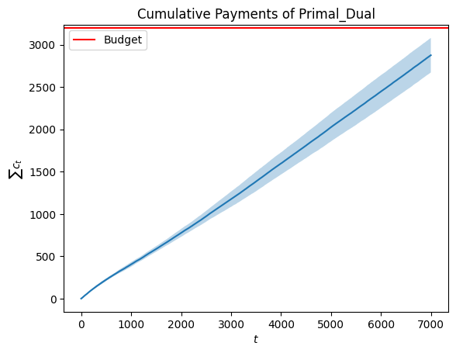
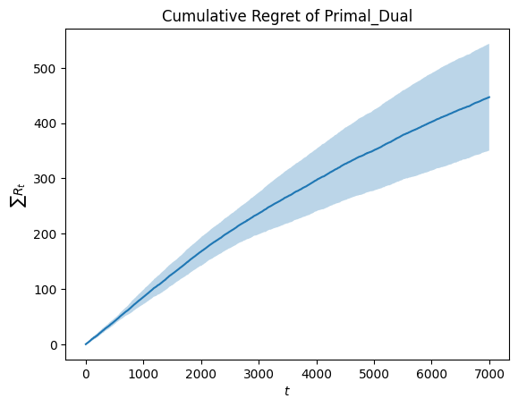
Results: Truncated Normal Environment
Chosen Prices: Clear concentration around one price peak (≈ 0.6–0.7). Still, large variance remains due to exploration and shifting optimal solutions. The agent frequently re-adjusts rather than locking onto a single value.
Cumulative Payments: Payments steadily rise but plateau well below the budget line. The agent avoids overspending but sacrifices potential revenue. Conservative budget pacing dominates.
Cumulative Regret: Sublinear growth. Regret per round decreases over time, confirming learning effectiveness. However, the widening uncertainty region reflects the instability of the clairvoyant benchmark in highly nonstationary settings.

Slide 32
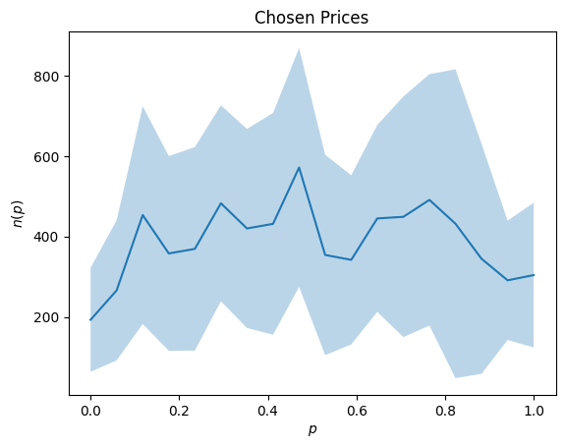
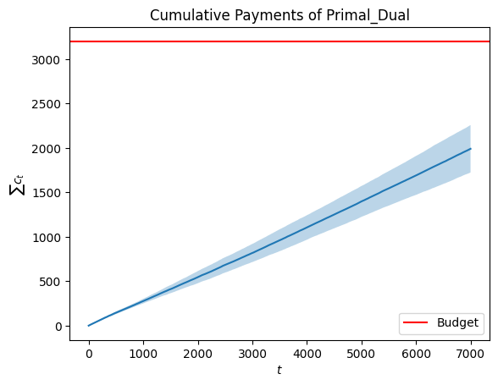
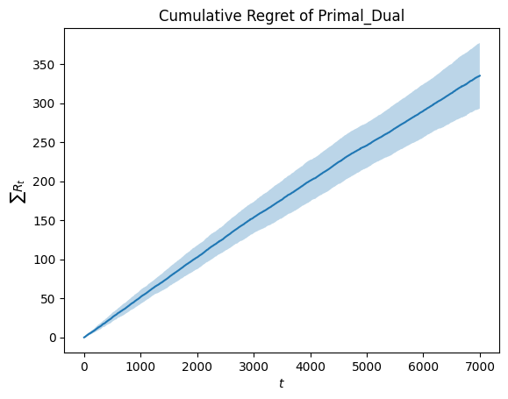
Results: Truncated Exponential Environment
Chosen Prices: Unlike Beta or Normal, no dominant peak emerges. Prices are scattered, reflecting the steeply shifting nature of exponential valuations. Exploration dominates, with wide uncertainty bands.
Cumulative Payments: Extremely conservative. Payments stay far below budget, revealing inefficiency. The agent adapts to frequent low-valuations but non utilizes opportunities for higher sales.
Cumulative Regret: Nearly linear growth compared to other environments, but variability across runs is smaller. Sublinearity is still present but weaker, suggesting the environment is hardest to learn in.

Slide 33
Key Insights
Budget Safety: Agent never overspends, always satisfies global constraint.
Conservatism: Leaves a significant fraction of the budget unused, especially in Exponential environments.
Exploration Costs: Wide variance in chosen prices shows persistent exploration.
Performance Differences:
Beta & Normal: identifiable dominant price.
Exponential: scattered choices, harder to exploit.
Regret: Always sublinear, confirming theoretical guarantees, but higher in harsher environments.
The proposed algorithm demonstrates the best-of-both-worlds property: it is both no-regret and budget-feasible.
The pacing mechanism successfully prevents overspending but may underutilize resources, especially in exponential environments.

Slide 34
Requirement 4: Best-of-both-worlds with multiple products

Slide 35
Goal:
Design algorithms that adapt to non-stationary multi-product pricing environments.
Must balance:
Exploration vs Exploitation (learn valuations while maximizing revenue).
Budget / resource constraints.
Best-of-both-worlds: near-optimal against stochastic and adversarial demand.

Slide 36
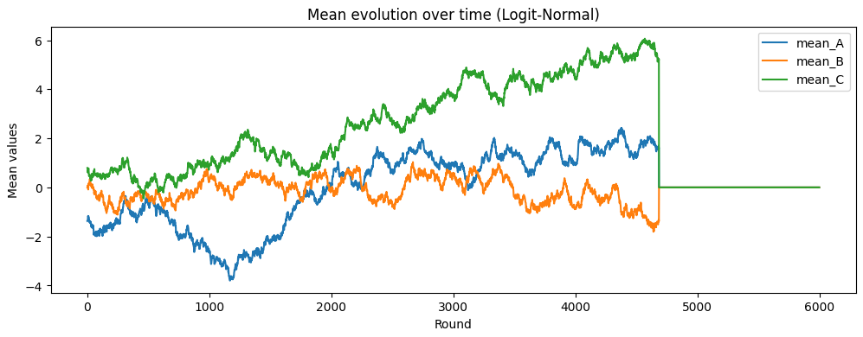
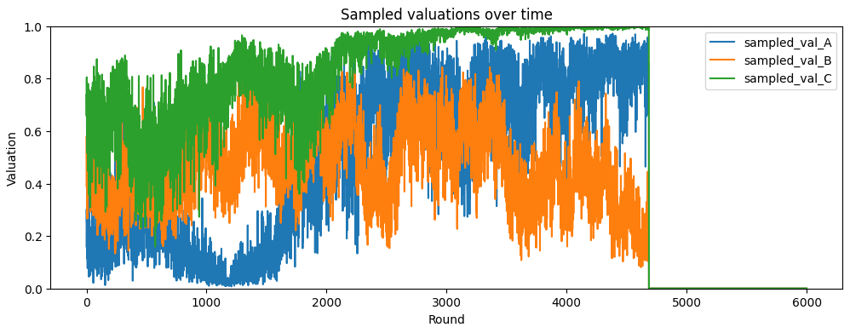
Environment: Multi-Product Pricing
Models consumer valuations as logit-normal distribution.
Supports multiple correlated products.
Key features:
Randomized valuations per round.
Valuations drift slowly over time (update_means).
Consumer buys if valuation ≥ price.
Provides:
round() → simulate purchases + revenue.
compute_Q() → probability demand curve per price.

Slide 37
Agent: Discounted EXP3.P
An adversarial bandit algorithm adapted for non-stationary environments.
Core mechanics:
Maintains exponential weights over arms (prices).
Uses bias correction for regret guarantees.
Adds discounting → adapts to changing environments.
Outputs:
Chosen arm (price).
Updated probabilities over arms.
Weights are multiplied by a discount factor

Slide 38
Agent: Primal-Dual Pricing
Wraps multiple EXP3.P agents (one per product).
Uses dual variable λ to enforce budget constraints.
Decision process:
Each product chooses price via its EXP3.P agent.
Agent updates weights based on Lagrangian reward (revenue – λ × constraint).
Updates λ to balance budget vs. revenue.
Provides:
Near-optimal pricing under global constraints.
History of price distributions, λ evolution.

Slide 39
Baselines for Evaluation
Clairvoyant LP:
Solves linear program with full knowledge of demand.
Used as benchmark upper bound.
Best fixed hindsight distribution:
Computes optimal fixed pricing strategy for entire horizon.
Provides another regret baseline.

Slide 40
Experiment Setup
Parallelized trial runs (joblib, multiprocessing).
Progress tracked with tqdm.
Each trial simulates:
Multi-product environment.
Agent interaction (Primal-Dual EXP3.P).
Logging: rewards, payments, regrets.
Visualizations:
Regret vs horizon.
Payments vs budget.
Evolution of valuations and λ.

Slide 41
Trial Setup: Budget < Horizon
Parameters:
Products = {A, B, C}
Budget = 4000, Horizon = 6000 rounds
Seeds: 20 randomized runs
Price discretization: ~17 levels between 0.01 and 1.0
Two modes:
Single Trial (run_one = 1): visualization of one trajectory.
Multiple Trials (run_one = 0): averages + confidence bands.

Slide 42
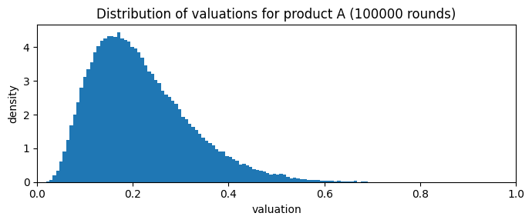
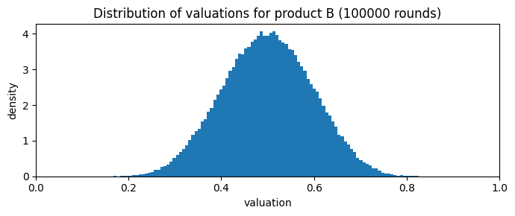
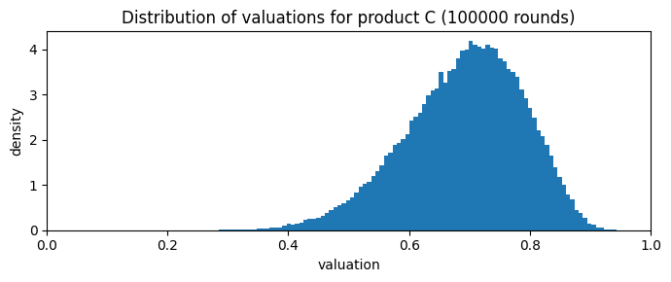
Single Trial Results
Observed Sales:
Product C sold most (highest mean valuation).
Product B sold moderately.
Product A rarely sold (low mean valuation).
Sometimes multiple products sold in the same round.
Regret Behavior:
Regret vs clairvoyant oracle is consistently lower.
Regret vs fixed hindsight oracle decreases slowly but steadily.
Sublinear growth → algorithm adapts effectively.

Slide 43





Single Trial Visuals
Figure 1: Cumulative regret vs oracle
Figure 2: Dual variable λ evolution
Figure 3–5: EXP3.P price probabilities over time for each product

Slide 44


Multiple Trials
Average over 20 seeds.
Regret:
Sublinear and lower vs clairvoyant oracle.
Sublinear vs fixed hindsight oracle.
Revenue / Payments:
Average cumulative payments track budget.
Variability across runs modest.

Slide 45
Price Discretization Sensitivity
Case 2: 5 fixed prices per product (coarse grid)
Less granularity, but still learns profitable prices.
Sublinear regret preserved.
Revenue still dominated by product C > B > A.
Case 1: ~17 prices per product (fine grid)
More exploration, higher computational cost.
Smooth regret curves, good adaptation.

Slide 46


Revenue and Regret Comparison
Revenue grows steadily, dominated by high-valuation product C.
Regret analysis:
Fixed hindsight oracle = hard benchmark → higher regret.
Clairvoyant oracle = easier benchmark → lower regret.
Sublinear regret growth = hallmark of good bandit learning.

Slide 47
Key Takeaways
Primal-Dual + Discounted EXP3.P adapts to non-stationary, multi-product, budget-constrained pricing.
Sublinear regret vs oracles confirms effectiveness.
Discounting not so relevant for tracking drifting valuations.
Works robustly across:
Single vs multiple trials.
Different price discretizations.

Slide 48

Case: Budget = Horizon (B = T)
Setup:
Budget = 6000, Horizon = 6000 rounds
Products = {A, B, C}
Price discretization: fine grid (~17 prices) or coarse (10 prices)
Goal: Compare learning behavior under matched budget and horizon.
Methodology:
Single trial (visualization).
Multiple trials (averaged results).

Slide 49





Single Trial (Fine Grid)
Agent gradually learns profitable prices.
Early variability: high prices sometimes exceed valuations → no sales.
Over time:
Product C and B have a price that is distinguishable from the others
A has more uniformly probable prices
Cumulative regret:
Sublinear and lower vs clairvoyant oracle.
Sublinear vs fixed hindsight oracle.
Discretization (17 prices) balances exploration and convergence.

Slide 50


Multiple Trials (Fine grid)
Across 20 seeds:
Consistent adaptation across trials.
Sublinear regret confirmed.
Fixed hindsight benchmark harder to track → higher regret.
Payments analysis:
Average cumulative payments approach budget.
Variability across runs smoothed out.

Slide 51


Multiple Trials (Coarse Grid: 5 Prices)
Restricts pricing to 5 discrete levels.
Outcomes:
Almost same regret than fine grid
Still shows sublinear growth across trials.
Features:
Coarse grid → faster computation and same regret.

Slide 52
Key Takeaways
When budget = horizon, exploration pressure is high:
Finer grids (17+ prices) allow near-optimal adaptation.
Coarse grids (5 prices) keeps same performances.
Sublinear regret persists across all cases.
Discounted EXP3.P + primal-dual remains robust:
Tracks valuations under nonstationarity.
Enforces budget constraints effectively.

Slide 53
Case: Budget > Horizon (B > T)
Setup:
Budget = 10,000
Horizon = 6,000
Products = {A, B, C}
Price discretization: fine grid (~17 prices) or coarse grid (10 prices)
Key difference from earlier cases:
Budget per-round ρ > 1 → more products sold per round more often.

Slide 54





Single Trial (Fine Grid)
Agent explores broadly in early rounds.
Cumulative regret decreases steadily:
Sublinear vs fixed hindsight oracle.
Sublinear vs clairvoyant oracle.
λ evolution: decreases up to 0.2 due to ρ > 1 .

Slide 55


Multiple Trials (Fine Grid)
20 randomized seeds averaged.
Observations:
Sublinear cumulative regret holds across trials.
Average payments reaches budget.
Revenue ranking remains C > B > A.
Exploration early, exploitation late → consistent adaptation.

Slide 56


Multiple Trials (Coarse Grid: 5 Prices)
Restricting to 5 prices per product.
Features:
Smoother regret for clairvoyant.
Still maintains sublinear growth.
Practical insight: coarse grids may suffice when computation is limited.

Slide 57
Key Takeaways
With budget > horizon, sell multiple products more often at each round.
Discounted EXP3.P + primal-dual continues to:
Achieve sublinear regret.
Allocate prices toward profitable products.
Stay robust under both fine and coarse discretizations.
Confirms flexibility of algorithm across different budget regimes.

Slide 58
Requirement 5: Slightly non-stationary environments with multiple products

Slide 59
Environment
The base environment is the same used for requirement 2:
Uses a multivariate logit-normal distribution to model customer preferences.
Product valuations are obtained by sampling from the distribution and applying a sigmoid function to rescale the value in [0, 1] range
To make it slightly non-stationary we define a specific number of intervals by considering the number of rounds each interval lasts and the distribution:
remain fixed during each interval
changes by randomly sampling new mean and standard deviation values between each interval.

Slide 60
Agent Case 1: UCB1 with GP and sliding window
We used the same agent used for requirement 2, a UCB agent with GP to model the products demand curve
To adapt it to the slightly non-stationary environment it was equipped with a sliding window mechanism:
During the GP update if the current sample exceeds the sliding window size the oldest sample is removed from the GP
This mechanism allows the agent to “forget” old samples and adapt to the variability of the environment

Slide 61
Agent Case 2: Primal-Dual with modified EXP3.P
This is the same primal dual agent used for requirement 4, which used an instance of EXP3.P for each product
Given that the environment is non-stationary we modified the EXP3.P algorithm by introducing a discount factor to discount the weights over time to somehow “forget” the past
For the Dual, we consider a smoothed update for each EXP3.P agent, each updated independently of the others

Slide 62
Baselines
We used 2 different baselines for comparison:
Clairvoyant:
Solves a linear program to compute the profit-maximizing price distribution for N products over K prices, subject to demand and unit constraints.
Returns the optimal probabilities, expected profit, and expected units used
Best fixed distribution hind slack:
computes the hindsight-optimal fixed price distribution across all rounds by solving a linear program that maximizes average expected revenue under a global sales constraint
This is used only with the Primal-Dual.

Slide 63


Trials with CombUCB1 agent
When the environment changes frequently the agent is struggling to achieve a sublinear regret. This is because the environment is almost non-stationary and the CombUCB1 agent is not suited for non-stationary environments.
Increasing the number of rounds after which the environment distribution changes the agent is able to achieve sublinear regret.

Slide 64


Trials with Primal-Dual agent
When the environment changes frequently the primal-dual agent show best performances since it’s specialized for non-stationary environments
When the environment becomes almost stationary the regret is still sublinear but the agent performances are worse.

Slide 65


Agents comparison B < T
With small change intervals the primal dual agent clearly outperform the CombUCB1 which is not effective in highly non-stationary environments.
While with an almost stationary environment the CombUCB1 agent is superior.

Slide 66


Agents comparison B = T
As expected with an environment which is almost completely non-stationary the CombUCB1 agent struggle to achieve sublinear regret.
Decreasing the number of intervals, the primal dual agent show worse performance as already seen before, while the almost stationary environment let the CombUCB1 agent outperform the primal dual one.

Slide 67


Agents comparison B > T
Increasing budget make the primal dual agent being outperformed by the CombUCB1 even in almost non-stationary environment.
As expected the CombUCB1 agent thrive with almost stationary environment also when B > T.

Slide 68
Conclusions
Requirement 1:
UCB1 no budget constraint –> sublinear regret
UCB1 with budget constraint –> sublinear regret
Requirement 2:
Combinatorial UCB (with GP) –> sublinear regret
Requirement 3:
Primal-Dual (EXP3.P) single product –> sublinear regret
Requirement 4:
Primal-Dual (EXP3.P) multiple products –> sublinear regret
Requirement 5:
Combinatorial UCB (with GP and SW) –> sublinear regret
Comparison between Combinatorial UCB (with GP and SW) and Primal-Dual –> coherent results
Further improvements:
Create new environments
Test each algorithm under different conditions (limit cases, new environments, different parameters,…)
Further optimize each algorithms by hyperparameters tuning

Slide 69
Useful Links
Github link to the Repository of the Project:
https://github.com/Digioref/OLA-Pricing.git
Paper of EXP3.P:
https://cesa-bianchi.di.unimi.it/Pubblicazioni/J18.pdf

